Slide 1



Water Quality Prediction

Slide 2

Learning Objectives
Understood the significance of clean water prediction and its impact on public health and environment.
Gained hands-on experience in handling real-world datasets related to water quality.
Learned to preprocess data for multi-output regression problems.
Developed a machine learning pipeline using MultiOutputRegressor with RandomForestRegressor.
Evaluated model performance using key metrics like R² Score and Mean Squared Error (MSE).
Visualized multivariate predictions and residuals using Matplotlib and Seaborn.
Built and interpreted predictive models to support environmental decision-making.
GOAL
Source :
www.freepik.com/

Slide 3


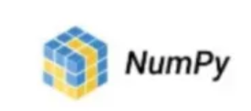




Tools and Technology used
Programming Language Python 3.12 – Core language used for data processing and model development.
Libraries and Frameworks
Pandas – Data manipulation and cleaning.
NumPy – Numerical operations and array handling.
Scikit-learn – Machine learning algorithms and model evaluation.
Matplotlib & Seaborn – Visualization of data distributions, trends, and model performance.
Machine Learning Techniques
MultiOutputRegressor – For handling multiple regression targets simultaneously.
RandomForestRegressor – Ensemble-based regression for robust predictions.
Development Environment
Jupyter Notebook – Interactive coding, model training, and result interpretation.
Joblib – Used to save and load the trained model and column structure for deployment

Slide 4
Methodology
Gathered real-world water quality datasets containing multiple chemical, stations and environmental parameters.
Data Collection
Handled missing values and Normalized data where necessary.
Selected relevant features and targets for regression.
Data Preprocessing
Used MultiOutputRegressor to handle multi-target regression.
RandomForestRegressor for robustness and accuracy.
Model Selection
Model Training Split the dataset into training and testing sets.
Trained the model using supervised learning techniques.
Model Training
Evaluation
Assessed performance using R² Score and Mean Squared Error (MSE) for each target parameter
Deployment
Saved the model and feature structure using Joblib.

Slide 5
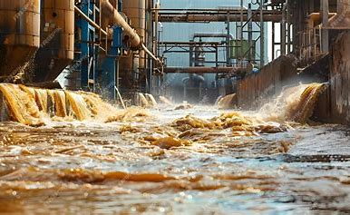
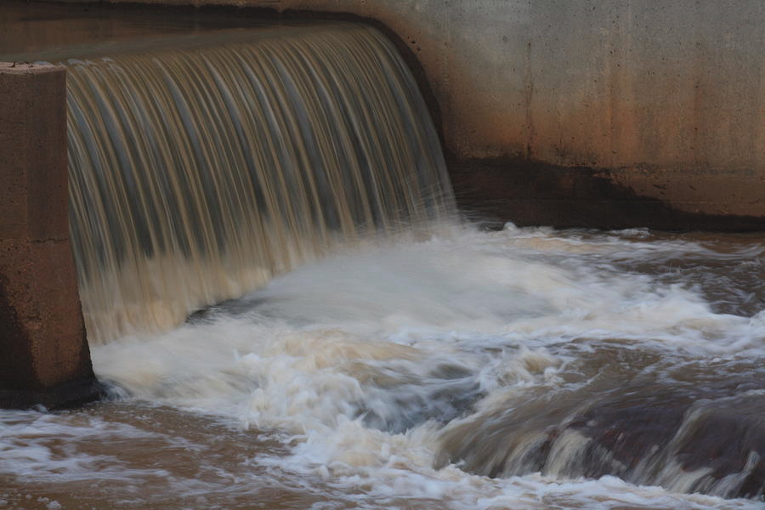
Problem Statement:
Access to clean and safe water is essential for health and development, but monitoring water quality is resource-intensive and often delayed.
Manual testing of water samples for multiple chemical parameters can be time-consuming and expensive.
There is a need for a predictive model that can estimate key water quality parameters based on available sensor or test data.
The goal is to enable early detection of pollution and facilitate automated water quality monitoring systems.

Slide 6
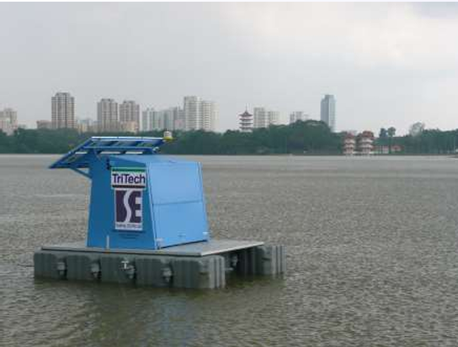
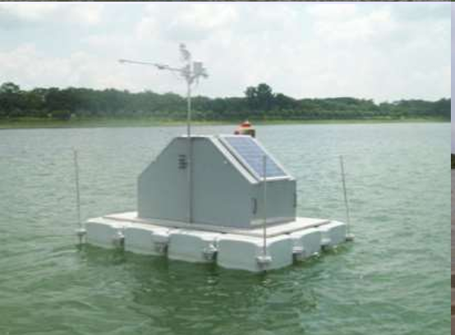
Solution:
Stations to predict water quality
Developed a machine learning-based predictive system to estimate multiple water quality parameters from input features.
Implemented a MultiOutputRegressor wrapped around a RandomForestRegressor to handle multiple targets efficiently.
Achieved reliable predictions for key parameters like NO2, PO4, NO3, CL, PO4, and more.
Used regression metrics (R² Score and MSE) to ensure model reliability and generalization.
Created an interactive Streamlit web app (app.py) to allow users to input water sample values and get predicted quality parameters instantly.
Enabled a low-cost, scalable, and automated solution for water monitoring.

Slide 7
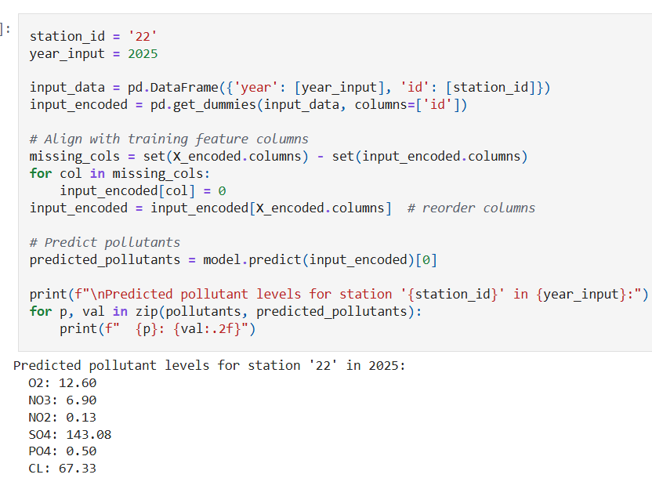
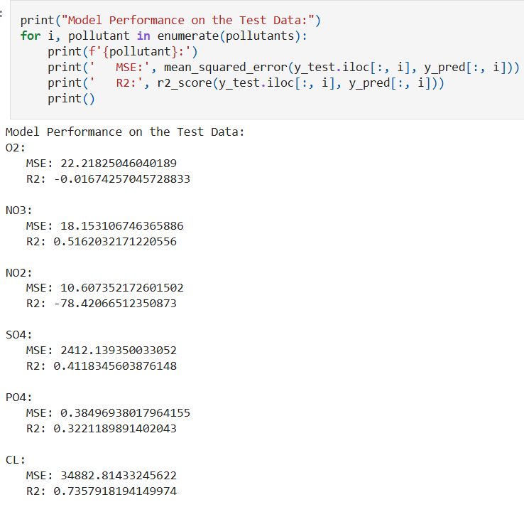
Screenshot of Output:
Testing the trained data
Using the Model to predict the pollutants levels of 2025

Slide 8
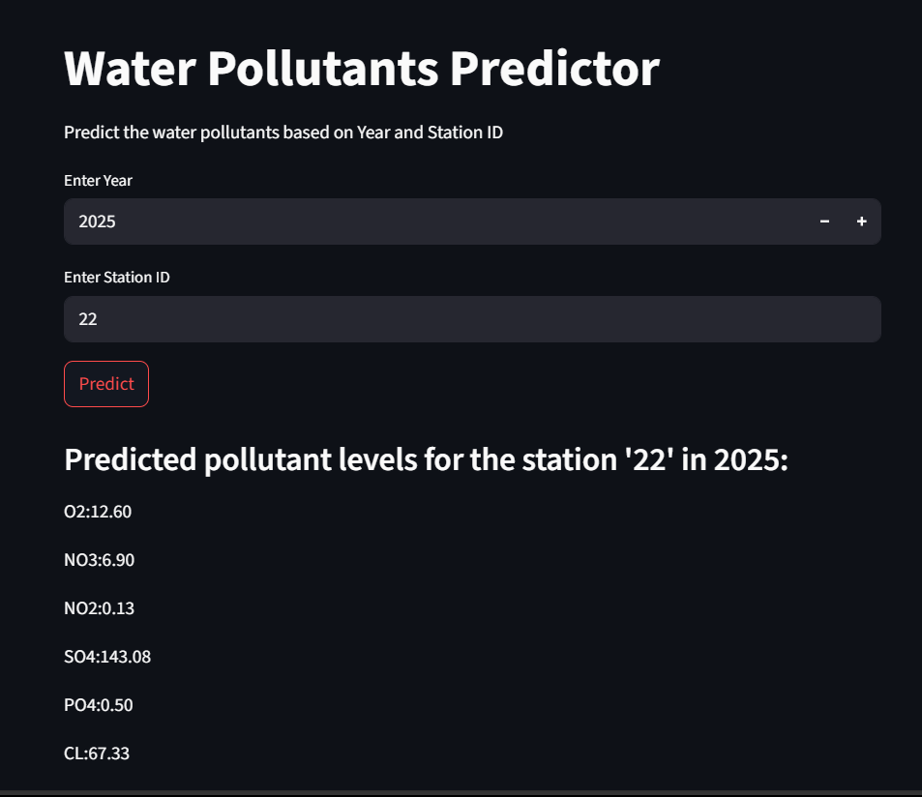
Conclusion:
Deployed the model using pickle file and used streamlit to deploy in the web
Successfully built a multi-output machine learning model to predict key water quality parameters with acceptable accuracy.
Demonstrated the practical application of AI in environmental monitoring and public health.
The use of Random Forests with MultiOutputRegressor proved effective for handling complex, multi-target regression problems.
Integrated the solution into an interactive and user-friendly Streamlit app, enhancing accessibility and usability.
This project highlights the potential of AI-driven tools to support real-time decision-making in water quality management.
Future enhancements could include integration with live sensor data, geospatial mapping, and automated alert systems.

Slide 9
Project Repository & Resources:
GitHub Repository
Access the complete source code, notebook, deployment app, and documentation here:
sid0804-max/water-quality-prediction: weekly project / main project
Google Drive Link
Trained model files are stored on Google Drive due to GitHub’s file size constraints.
Water Quality Prediction model pickle file - Google Drive

